Slide 1

2026
MOP LAUNCHING
DRAFT PLAN
Prepared by Khoi Ta

Slide 2
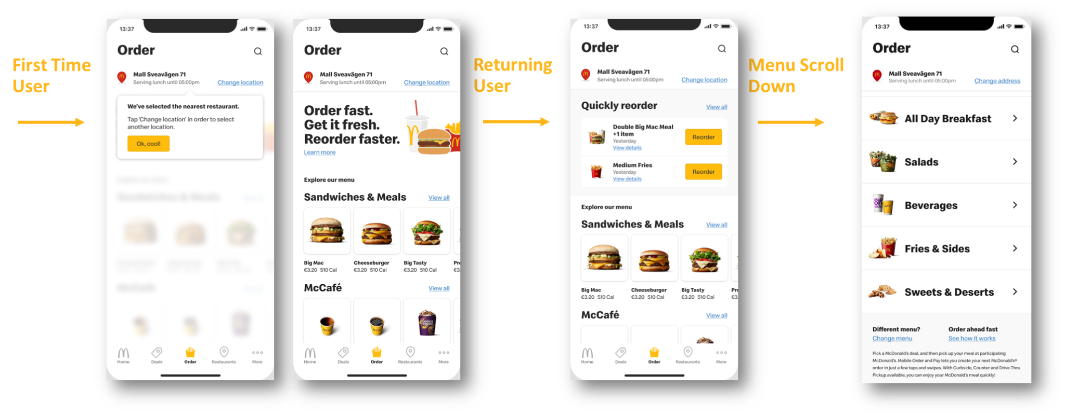
MOP Launching - Order Wall

Slide 3
MOP Campaign Roadmap (reference)
Reinforce “Feel Good Moment” by offering customers new GMAL feature. Whether you are eating in the restaurant or enjoy food at home, it’s always the most convenient experience
AWARENESS: 25/5 - 14/6 (3 wks)
AMPLIFIED: 15/6 - 12/7 (4 wks)
RETAIN: 13/7 - 7/8 (4 wks)
1
Introduce MOP as an convenience and friendly ways to enjoy good moments with McD
2
Trigger FOMO to drive customers to the store to try for themselves
3
An all-rounder app in your hand: not just MOP but also earn & burn points for exclusive moments
[owned] Store activation
Intro clip + key visual
[owned] Exclusive bonus points / in-app offers
Partners’ offers
[owned] Crew competition
Lucky draw announcement
[owned] Exclusive bonus points / in-app offers
Partners’ offers
[owned] Crew competition
Lucky draw: 3 rewards
Animation for all app features
Exclusive offer & merch from McD & partners
[owned] Crew competition
Lucky draw: 2 rewards
Fanpage, IG, Tiktok, Threads
In-app push, in-store POSM
Community Group
Fanpage, IG, Tiktok, Threads
In-app push, in-store POSM
Community Group
Fanpage, IG, Tiktok, Threads
In-app push, in-store POSM

Slide 4
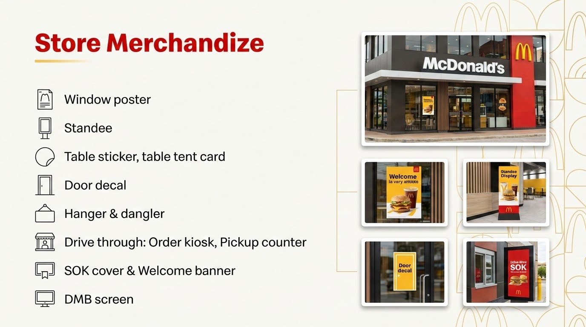

Slide 5
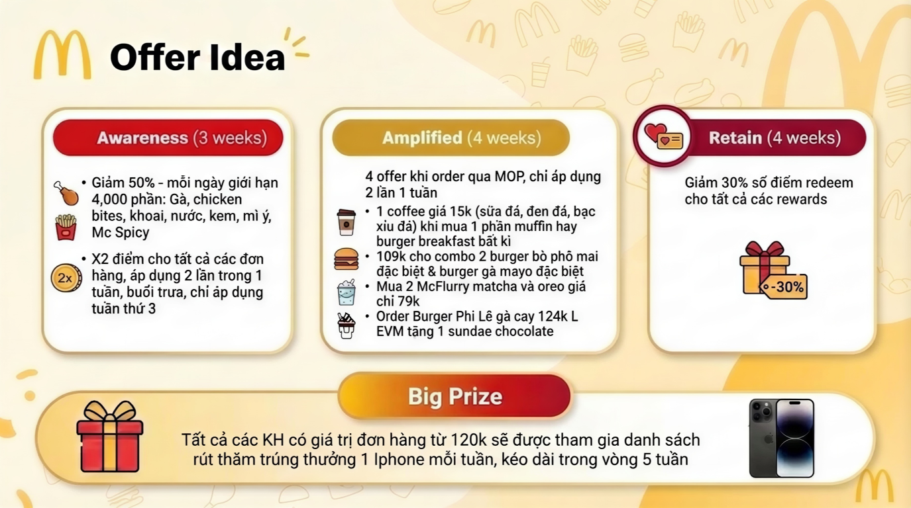

Slide 6
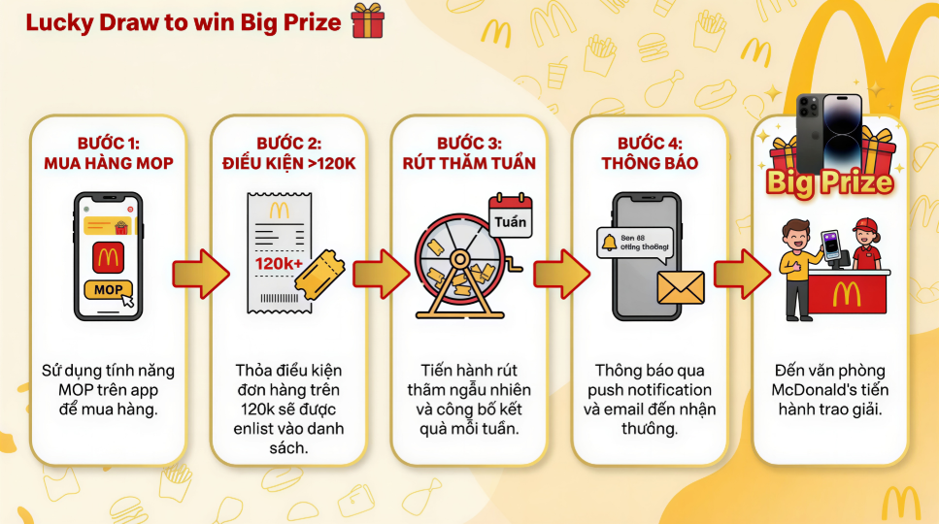

Slide 7
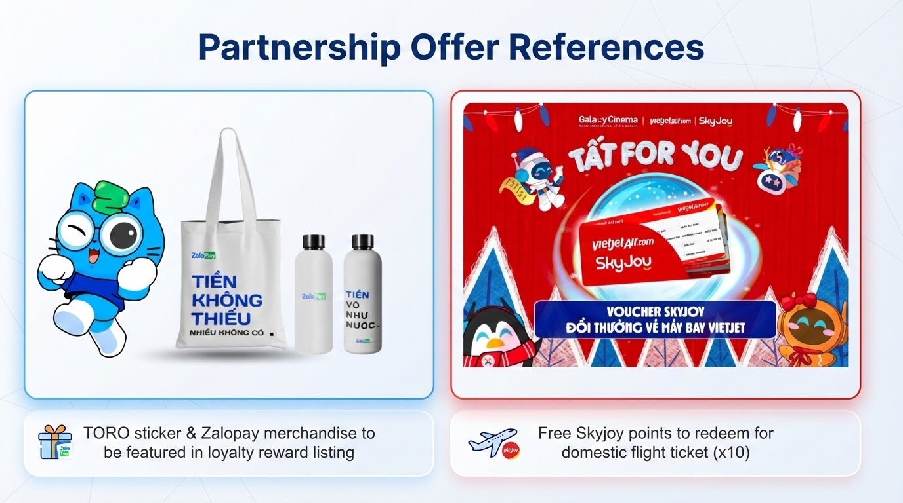

Slide 8







MOP Launching - Expected Timeline
Market kick off & market prework - configuration
mid Jan - mid Feb
Market acceptance testing
mid Feb - 6 weeks
Pilot
Apr
Master timeline
Com Plan Development
mid March - mid Apr
Market activation
mid May - 2 weeks
MOP campaign launching
Last week of May / 1st week of June

Slide 9
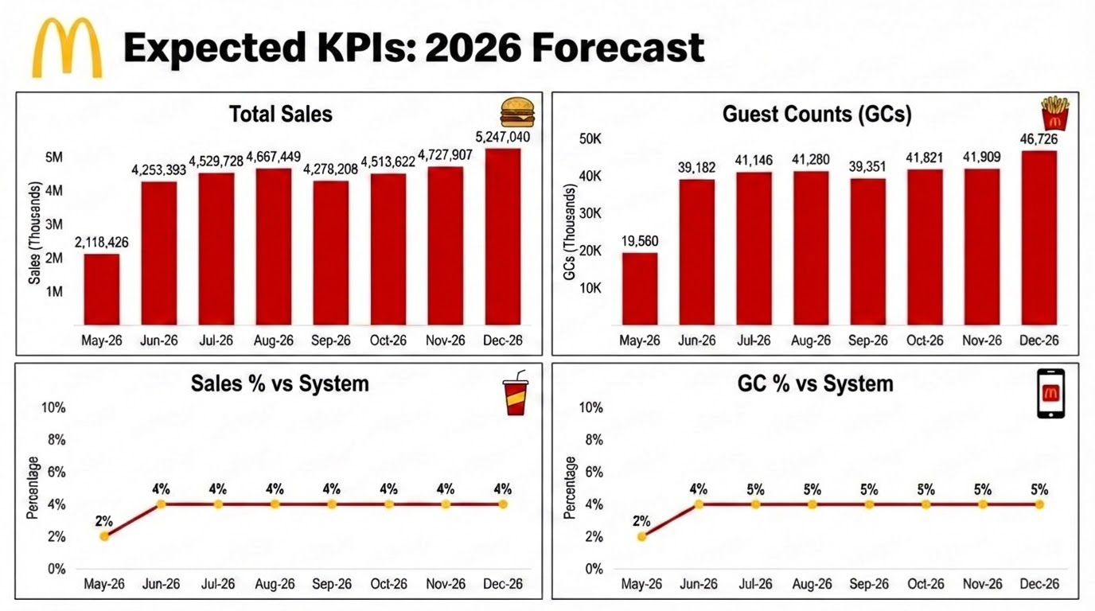

Slide 10
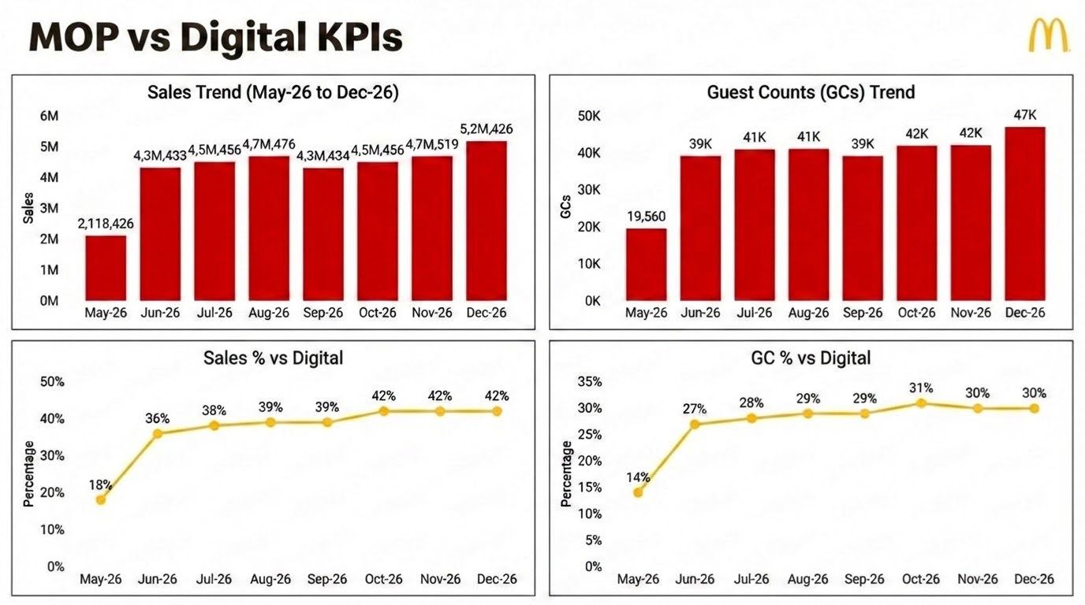

Slide 11
Detailed Budget Breakdown (Updated)
Hạng mục (Category) | Tỷ trọng (%) | TỔNG CAMPAIGN |  | AWARENESS |  | AMPLIFIED |  | RETAIN
 |  | Ngân sách (VNĐ) | KPI (Installs) | Ngân sách (VNĐ) | KPI (Installs) | Ngân sách (VNĐ) | KPI (Installs) | Ngân sách (VNĐ) | KPI (Installs)
Crew Incentive (Thưởng đội ngũ) | 9% | 100,000,000 | 15,000 | 40.000.000 | 6.000 | 30.000.000 | 4.500 | 30.000.000 | 4.500
Partnership Offers (Ưu đãi đối tác) | 26% | 300,000,000 | 6,000 | 120.000.000 | 2.400 | 90.000.000 | 1.800 | 90.000.000 | 1.800
Exclusive Offers (Ưu đãi độc quyền) | 13% | 150,000,000 | 3,000 | 60.000.000 | 1.200 | 45.000.000 | 900 | 45.000.000 | 900
Giải thưởng (Bốc thăm may mắn) | 14% | 160,000,000 | 3,200 | 56.000.000 | 1.120 | 42.000.000 | 840 | 42.000.000 | 840
Vận hành + Registration (POSM) | 12% | 140,000,000 |  | 0 |  | 0 |  | 0
Social seeding (Paid media) | 26% | 300,000,000
TỔNG CỘNG | 100% | 1,150,000,000 | 27,200 | 276,000,000 | 12.800 | 207.000.000 | 9.600 | 207.000.000 | 9.600

Slide 12

Thank you

